Slide 1




GigaSpaces Cloudify Any App, On Any Cloud, Your Way
Groovy DSL in Cloudify The why, the where and the how
February 2012
Barak Merimovich
Cloudify Team Leader
GigaSpaces

Slide 2
Agenda
Cloudify – A quick overview
What is a DSL?
Why use a DSL for Cloudify Recipes?
Why Groovy?
The Cloudify Groovy DSL

Slide 3
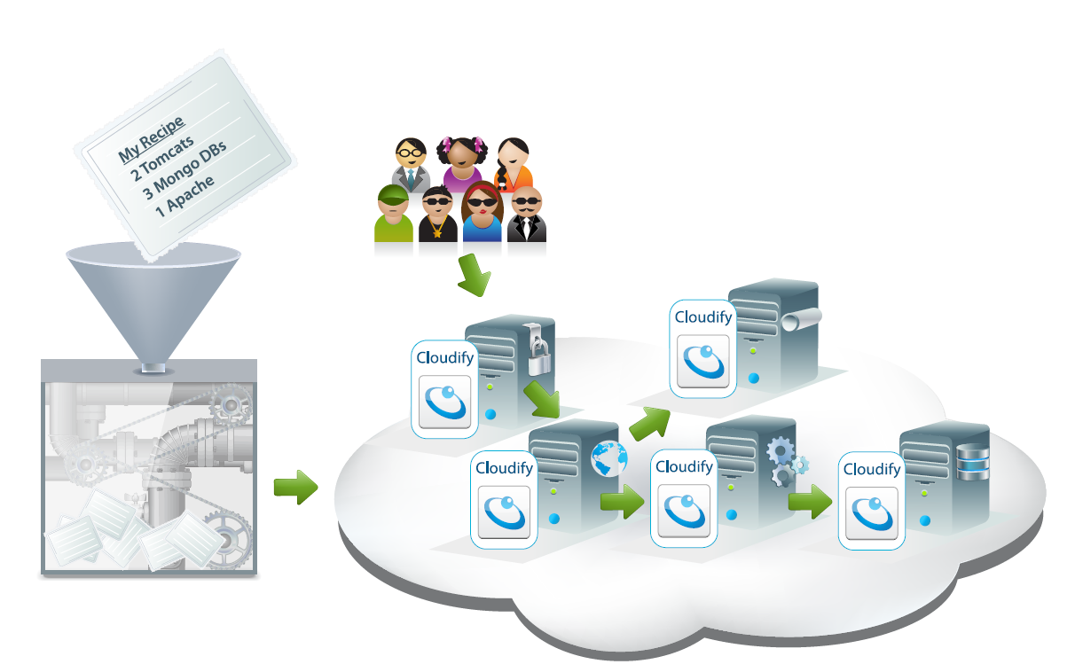
Cloudifying Enterprise applications is easy
Using Recipes
Cloudify On-Boards
Any App
Onto Any Cloud
Unchanged

Slide 4
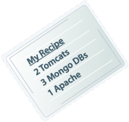




Cloudify creates virtual machines and installs agents

Slide 5






Cloudify agents install and manage your application

Slide 6


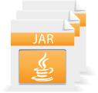


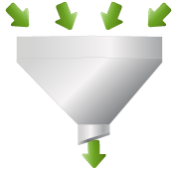


Application description through RECIPES
Recipe DSL
Lifecycle scripts
Availability & Monitoring
Probes
Custom plug-ins(optional)
application {
name="petclinic"
service {
name = "mongod"
}
service {
name = "mongoConfig"
}
service {
name = "apacheLB"
}
service {
name = "mongos"
dependsOn = ["mongoConfig", "mongod"]
}
service {
name = "tomcat"
dependsOn = ["mongos","apacheLB"]
}
}

Slide 7
Application description through RECIPES
Recipe DSL
Lifecycle scripts
Availability & Monitoring
Probes
Custom plug-ins(optional)
service {
name "mysql"
icon "mysql.png"
type "DATABASE"
...
}

Slide 8
Application description through RECIPES
Recipe DSL
Lifecycle scripts
Availability & Monitoring
Probes
Custom plug-ins(optional)
Lifecycle {
install "mysql_install.groovy"
start "mysql_start.groovy"
startDetectionTimeoutSecs 900
startDetection "mysql_startDetection.groovy"
stopDetection {
!ServiceUtils.isPortOccupied(jdbcPort)
}
preStop ([
"Win.*":"killAllMysql.bat",
"Linux.*":"mysql_stop.groovy”
])
shutdown ([
"Linux.*":"mysql_uninstall.groovy"
])
}

Slide 9
Application description through RECIPES
Recipe DSL
Lifecycle scripts
Availability & Monitoring
Probes
Custom plug-ins(optional)
monitors {
def ctxPath = ("default" == context.applicationName)?"":"${context.applicationName}“
def metricNamesToMBeansNames = [
"Current Http Threads Busy": ["Catalina:type=ThreadPool,name=\"http-bio-${currHttpPort}\"",
"currentThreadsBusy"],
"Current Http Thread Count": ["Catalina:type=ThreadPool,name=\"http-bio-${currHttpPort}\"",
"currentThreadCount"],
return getJmxMetrics("127.0.0.1",currJmxPort,metricNamesToMBeansNames)
}

Slide 10
Application description through RECIPES
Recipe DSL
Lifecycle scripts
Availability & Monitoring
Probes
Custom plug-ins(optional)
scalingRules ([
scalingRule {
serviceStatistics {
metric "Total Requests Count"
statistics Statistics.maximumThroughput
movingTimeRangeInSeconds 20
}
highThreshold {
value 1
instancesIncrease 1
}
lowThreshold {
value 0.2
instancesDecrease 1
}
}
])

Slide 11
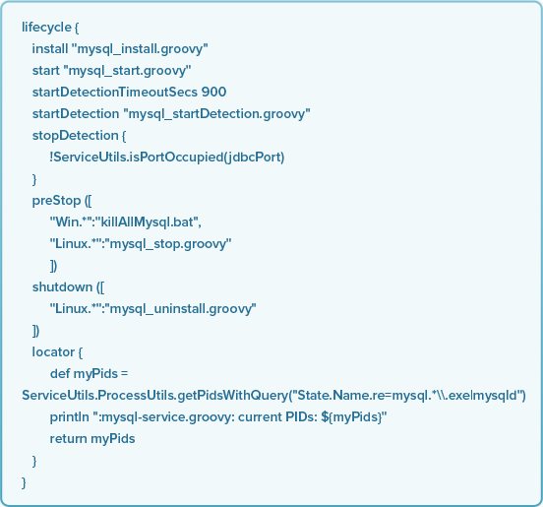
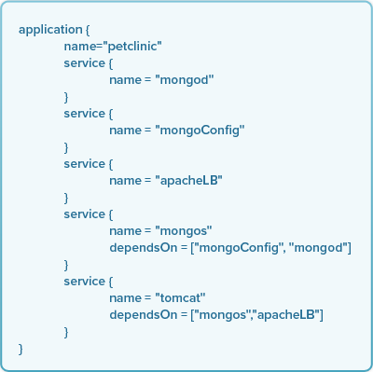
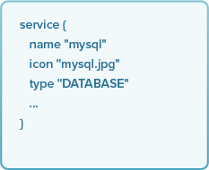
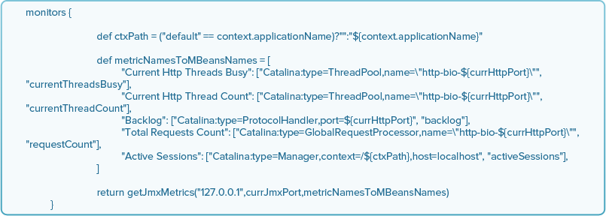
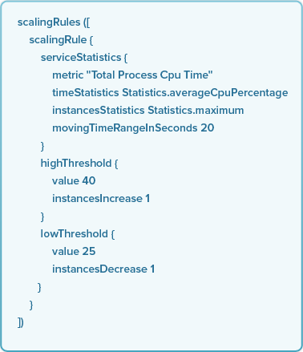
Application description through RECIPES
Recipe DSL
Lifecycle scripts
Availability & Monitoring
Probes
Custom plug-ins(optional)

Slide 12
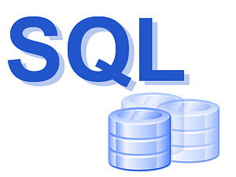
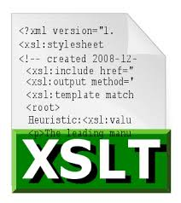

What is a DSL?
A domain-specific language (DSL) is a programming language or specification language dedicated to a particular problem domain, a particular problem representation technique, and/or a particular solution technique.
Some examples:

Slide 13
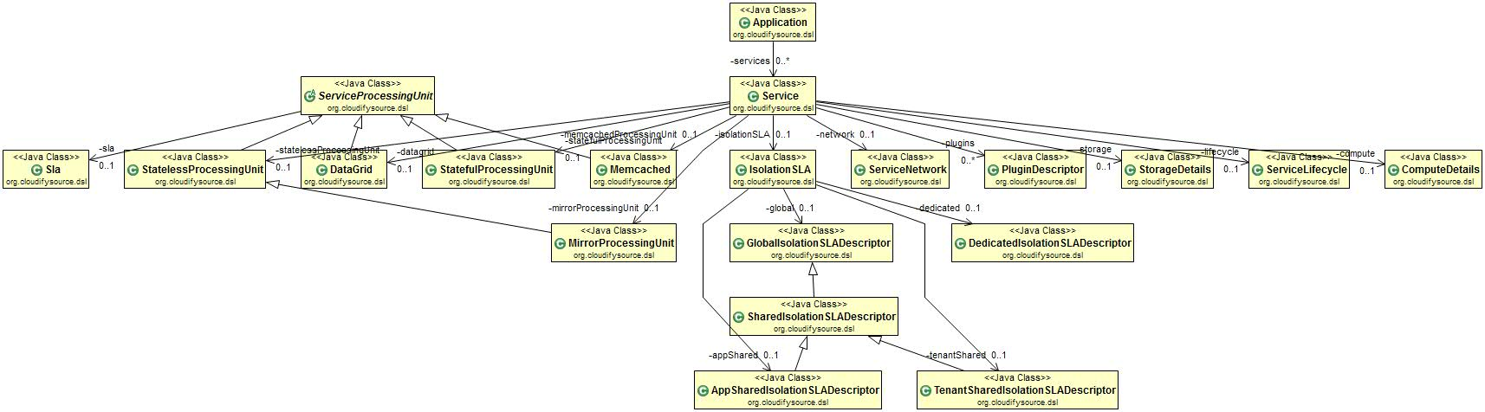
Why use a DSL – Product requirements
The Cloudify Domain model is complex – Need to model the complete lifecycle of a service: machine startup, bootstrapping, installation, etc…

Slide 14
Why use a DSL – Product requirements
Target audience is devops, though not necessarily dev…
Keep It Simple.
Recipe needs to be easy to read, modify and validate.
Should not look like code.
But allow for complex use cases for power users.

Slide 15
WHY use a DSL – technical requirements
Strongly typed domain model
Easy to use objects in code
Easy to validate
Easy to modify domain model without changing parser code
Ideally, adding new fields to existing objects should require no additional code.
Allow code snippets inside configuration file (“mySpecialField_” + someVariable)
But don’t want to write a full fledged language
Developer tools – IDE, Code completion

Slide 16
Why Groovy
Java Friendly
DSL Friendly
Language is customizable by design
Lots of community support, libraries and tools
Notes:
Java Friendly (Cloudify is developed using Java, though Recipes can run whatever language/platform they want)
Built-in DSL support (though we didn’t really use it…)
Lots of Buzz around the language
Many Groovy features make customizing the language easy – ideal for creating your own format.
Oh yeah, we already package it with Cloudify.

Slide 17
Some Groovy concepts
Groovy is an object-oriented programming language for the Java platform.
It is dynamically compiled to Java Virtual Machine (JVM) bytecode and interoperates with other Java code and libraries.
A Groovy script is fully parsed, compiled, and generated before execution (similar to Perl and Ruby). This occurs under the hood, and the compiled version is not saved.
Each attribute/method invocation in Groovy goes through the metaclass registry. Enables changing a class at runtime.

Slide 18
Groovy is very DSL friendly
Groovy's syntax allows to omit parentheses and dots in some situations.
This: take(coffee).with(sugar, milk).and(liquor)
Is equivalent to: take coffee with sugar, milk and liquor
Closures - similar to a "method pointer", enabling code to be written and run in a later point in time.
For example: def operations = {
declare 5
sum 4
divide 3
print }

Slide 19
Groovy features we really liked
Allows overriding getProperty(), propertyMissing() among others
Enables intercepting calls to an object and specifying an action for them
Native syntax for lists and maps.
def someList = [‘My value', ‘Your Value']
def someMap = [ ‘Some Key' : 31, ‘Some Other Key' : 28]
Expressions embedded inside strings
println “Hello ${world}”
Native support for various languages
XML – useful for manipulating configuration files.
ANT – just plain useful.

Slide 20
Let’s see the code

Slide 21
LOADING a GROOVY DSL FILE FROM JAVA
The most important class you should know is groovy.lang.GroovyShell
Easiest example of usage:
Object result = new GroovyShell().evaluate(new File(path))
This runs the groovy runtime with the given file, just like running the groovy command line.
Now let’s ‘tweak’ the shell to process our DSL Format.

Slide 22
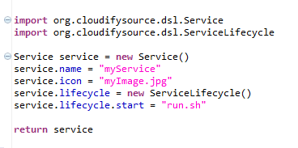
Let’s start with a basic groovy file

Slide 23
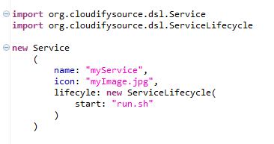
Use Constructor with named parameters

Slide 24
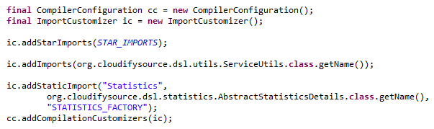
Add Import customizer to groovy shell

Slide 25
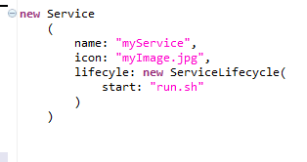
Better, but needs a bit more

Slide 26
Override script base class
A Groovy script is compiled into a Java class.
The Groovy commands run in the run() method.
The created Groovy class extends the groovy.lang.Script class.
Default implementations of:
get/setProperty
invokeMethod
println
Use GroovyShell to replace default base script class with our own implementation.

Slide 27

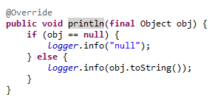
Override script base class
Tweak a few small things, like redirecting println() to Logger

Slide 28
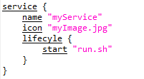
And tweak some more
Override invokeMethod() and setProperty()
Map method names to domain objects
If not a domain object, map to field name of current object

Slide 29

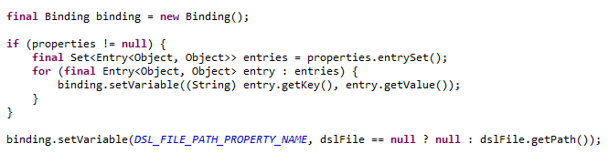
Load an optional properties file and bind to shell
Bind to Groovy Shell

Slide 30
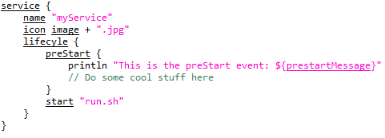
Easy to read, but still powerful

Slide 31
Grab the codE
The Cloudify web site:
http://www.cloudifysource.org
And on github:
https://github.com/CloudifySource/cloudify
https://github.com/CloudifySource/cloudify-recipes
See the actual code:
https://github.com/CloudifySource/cloudify/blob/master/dsl/src/main/java/org/cloudifysource/dsl/internal/DSLReader.java
https://github.com/CloudifySource/cloudify/blob/master/dsl/src/main/java/org/cloudifysource/dsl/internal/BaseDslScript.java

Slide 32
Questions
The Cloudify dev team is available on the Cloudify forum:
https://cloudifysource.zendesk.com/home
and bug tracker:
https://cloudifysource.atlassian.net/

